Slide 1


M.TECH DISSERTATION DEFENSE & MID-SEMESTER EVALUATION
Evidence-Grounded Generative AI for
Vulnerability-to-Threat Investigation
Context-Aware Prioritization Engine & Telemetry-Correlated Hallucination-Mitigated Defense
Candidate: Daipayan Ghosal (BITS ID: 2022wa86002)
Degree: M.Tech in Computing Systems & Infrastructure (Work Integrated Learning Programmes)
Course: CSIW ZG628T – Dissertation | Semester: First Semester 2026-27 | Birla Institute of Technology & Science, Pilani
Supervisor: Ms. Nidhi Kashyap (Analyst, Cybersecurity Practice, Wipro Limited, Pune)
Examiner: Mr. Satish Banigole (Project Manager, Wipro Limited, Pune)

Slide 2
EXECUTIVE CONTEXT & MOTIVATION
The Threat Triage Crisis: Scale, Burnout & Alert Fatigue
Why modern enterprise SOCs are failing under the deluge of uncontextualized vulnerability disclosures.
29,000+
Annual CVE Disclosures
Over 80 new vulnerabilities reported daily in NVD
56.4%
CVSS High / Critical
Majority rated >= 7.0 without context
45 Mins
Avg. Triage Per Alert
Manual cross-referencing across disconnected portals
67%
SOC Analyst Burnout
Alert fatigue leads directly to missed breaches
1. Static Severity Blindness
• CVSS Base scores evaluate intrinsic theoretical severity in complete isolation.
• A CVSS 9.8 vulnerability on an isolated offline lab server is prioritized over a CVSS 5.5 vulnerability actively exploited in the wild on an edge gateway.
• No awareness of asset criticality, business impact, or exposure boundary.
2. Operational Alert Fatigue
• Enterprise security analysts are inundated by thousands of daily scanner alerts.
• Correlating threat intelligence (NVD, CISA KEV, MITRE ATT&CK) requires manual swivel-chair investigation across 4+ tools.
• Result: Remediation backlogs stretch to 120+ days for critical systems.
3. The Ungrounded AI Trap
• Raw Large Language Models (LLMs) hallucinate 25-40% of facts when queried on cyber threat intelligence.
• Fabricate non-existent CVE IDs, invent fake exploitation commands, and misattribute threat actor TTPs.
• Dangerous for operational cyber defense without hard mathematical grounding.
BITS Pilani (WILP) | CSIW ZG628T Dissertation | Daipayan Ghosal (2022wa86002)
Slide 2 of 26

Slide 3
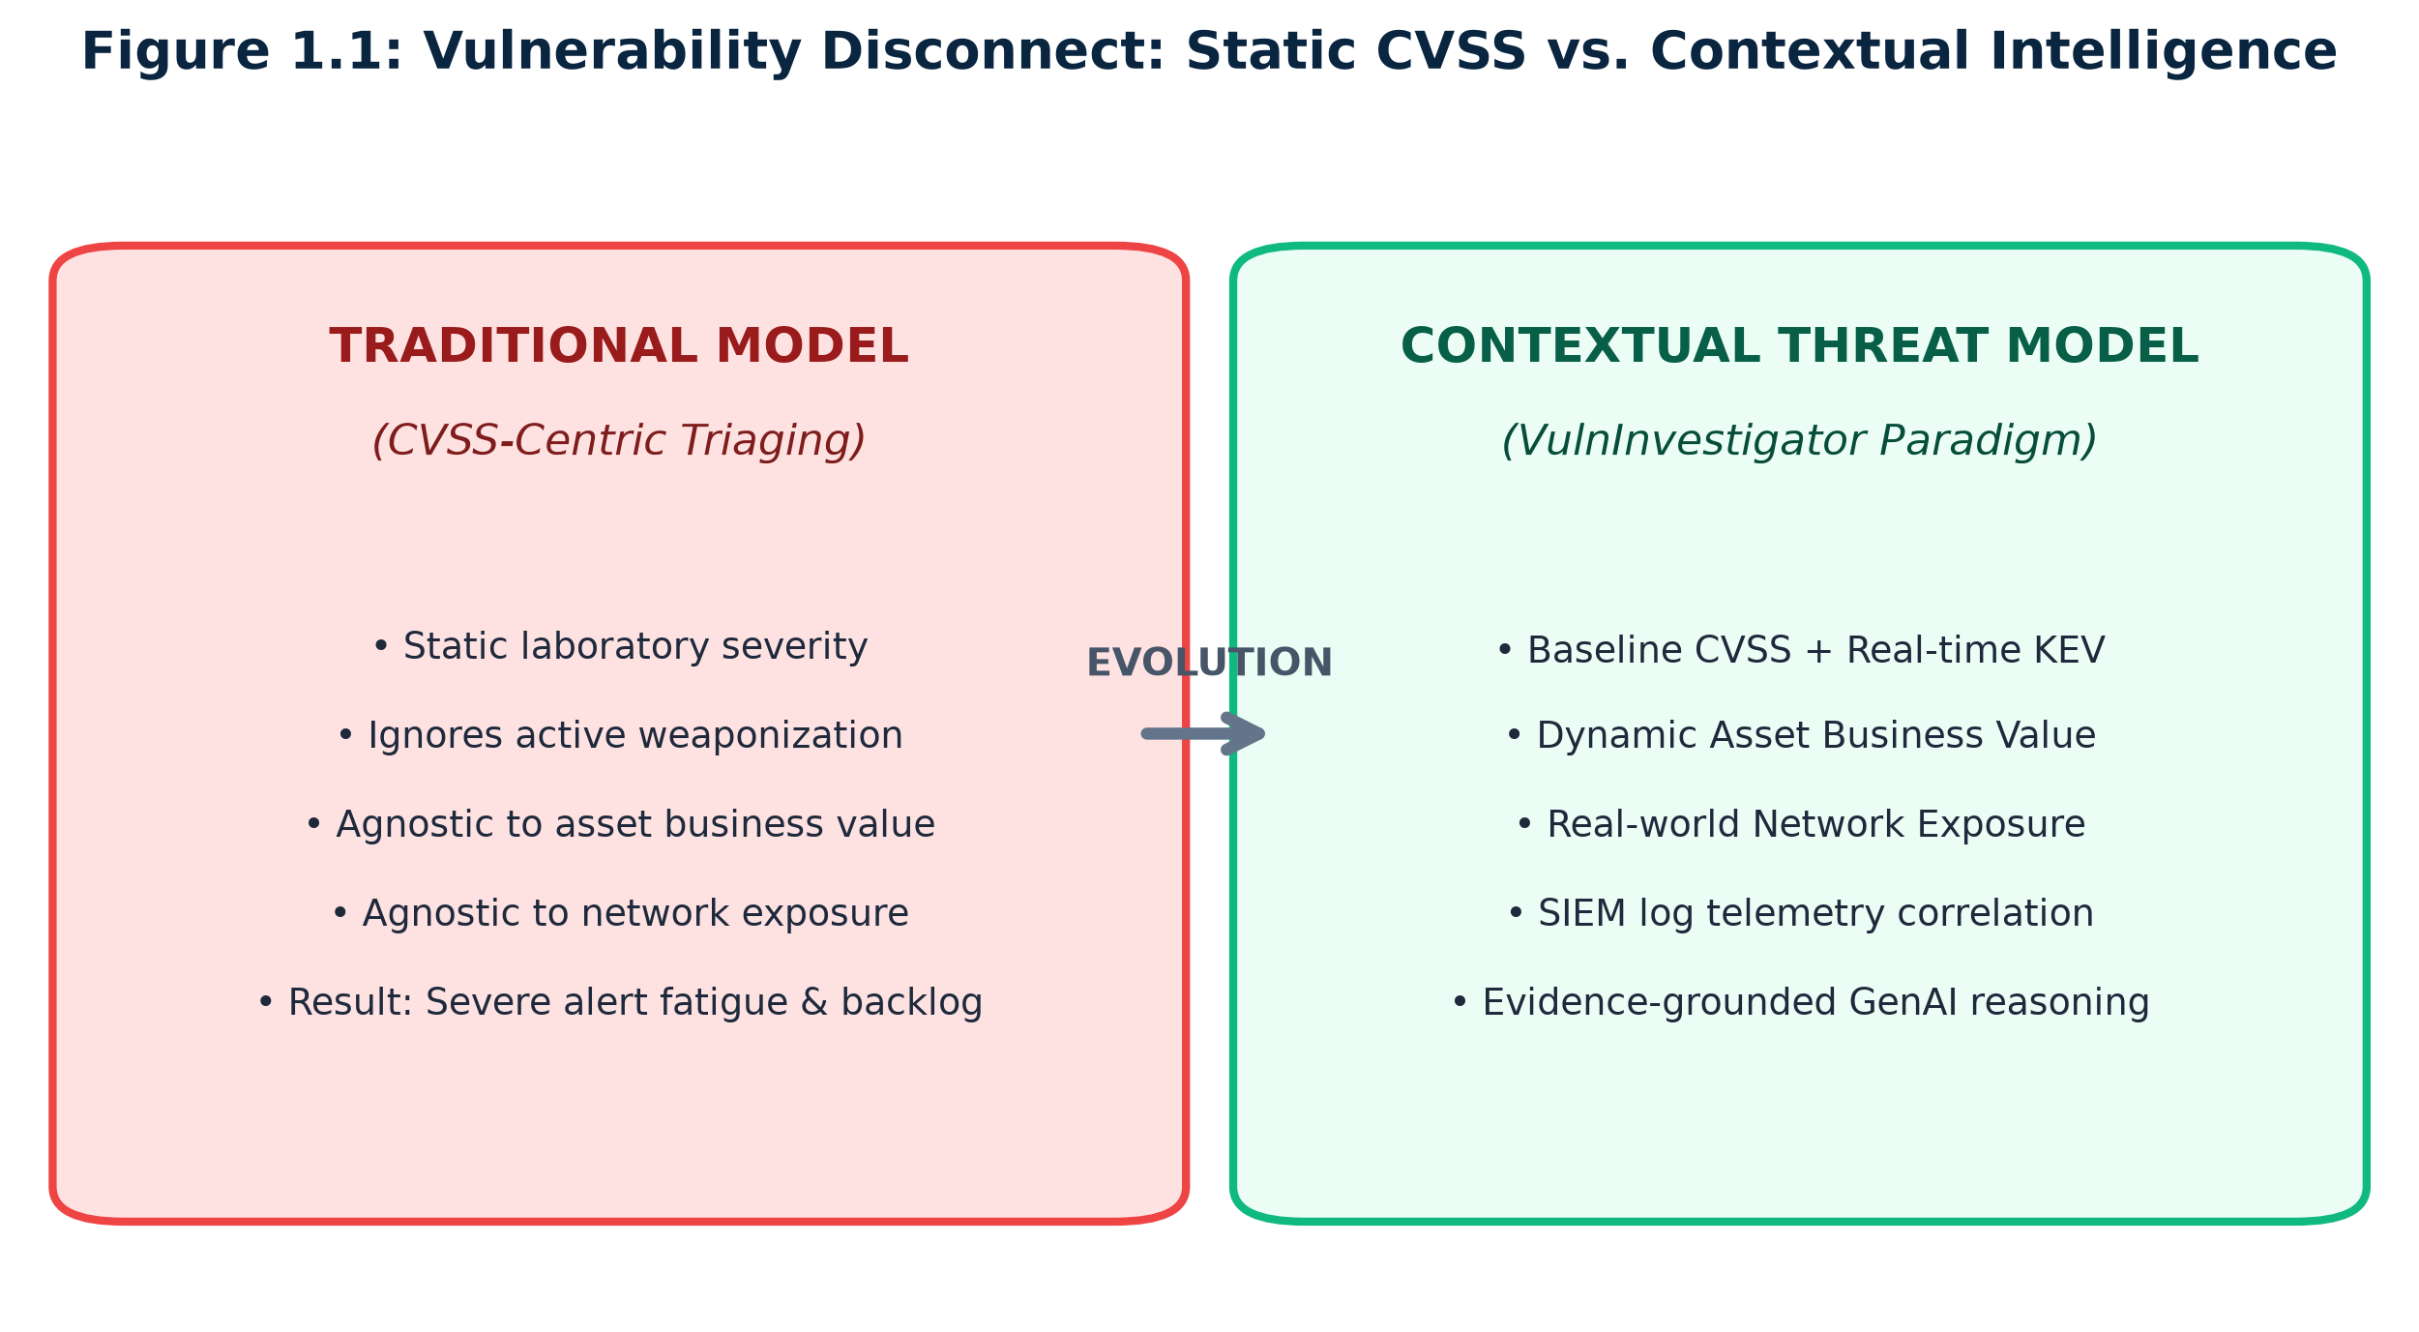
THEORETICAL & EMPIRICAL PROBLEM
The CVSS Disconnect: Static Severity vs Contextual Reality
Comparative breakdown showing why CVSS fails in live enterprise threat prioritization.
Key Paradigm Comparison
• CRITICAL CVSS LIMITATION:
• CVSS measures theoretical intrinsic severity (Attack Vector, Complexity, Privileges, Impact) in a laboratory vacuum.
• It is blind to whether the software is deployed on a critical Domain Controller or an isolated testbed.
•
• THE VULNINVESTIGATOR SOLUTION:
• Bifurcated 4-factor deterministic scoring engine integrating:
• • Normalized CVSS Base Severity (35% weight)
• • Business Asset Mission Criticality (25% weight)
• • Network Perimeter Exposure Zone (25% weight)
• • CISA KEV Active Exploitation Status (15% weight)
•
• REAL-WORLD OUTCOME:
• Drastically deprioritizes harmless lab CVEs while instantly escalating actively exploited perimeter flaws.
BITS Pilani (WILP) | CSIW ZG628T Dissertation | Daipayan Ghosal (2022wa86002)
Slide 3 of 26

Slide 4
AI IN CYBER DEFENSE
The Generative AI Paradox: Promise vs Hallucination Risks
Balancing the natural language synthesis power of LLMs against the catastrophic risk of fabricated telemetry.
The Promise of LLMs in SecOps
• Rapid Synthesis: Summarize complex 100-page advisory documents into 3-bullet executive briefings in seconds.
• Defensive Query Authoring: Automatically generate SIEM correlation queries (Splunk SPL, Elastic KQL) for immediate verification.
• Threat Hunting Hypotheses: Translate raw firewall events and EDR process trees into human-readable attack narratives.
• Junior Analyst Augmentation: Bridge experience gaps and guide step-by-step incident containment procedures.
The Fatal Hallucination Threat
• Fabricated Identifiers: Inventing fictitious CVE numbers (e.g. CVE-2026-99999) that waste hours of investigation.
• TTP Confusion: Mapping attacks to incorrect MITRE ATT&CK techniques (e.g. confusing Credential Dumping with Exfiltration).
• Invented Telemetry: Reporting fictitious compromised IP addresses and fictitious SIEM log signatures.
• Regulatory & Liability Danger: Producing ungrounded compliance reports that fail formal cybersecurity audits.
The VulnInvestigator Mandate: Evidence-Grounded Synthesis
• Never permit the LLM to calculate risk scores or infer exploitability without empirical proof.
• Enforce strict negative constraints: 'Cite ONLY provided log IDs, IPs, and techniques. If telemetry is missing, explicitly state so.'
BITS Pilani (WILP) | CSIW ZG628T Dissertation | Daipayan Ghosal (2022wa86002)
Slide 4 of 26

Slide 5
METHODOLOGICAL RIGOR
Research Questions & Formal Hypotheses
Defining the scientific boundaries and measurable success criteria for the dissertation.
Research Question 1 (RQ1): Contextual Re-Ranking
• PROBLEM INQUIRY:
• Can a deterministic mathematical scoring model incorporating asset criticality, network perimeter exposure, and in-the-wild exploitation significantly and defensibly alter the prioritization order of vulnerabilities compared to static CVSS v3.1?
•
• FORMAL HYPOTHESIS 1 (H1):
• Prioritization under VulnInvestigator S_ctx will diverge radically and statistically significantly from CVSS Base S_base, quantified by a Kendall's rank correlation coefficient:
• tau(S_ctx, S_base) < 0.65 (p < 0.001)
• and Normalized Discounted Cumulative Gain at Top-10:
• nDCG@10 < 0.55
•
• VALIDATION:
• Proves that environmental context and active exploitation fundamentally transform enterprise triage priorities.
Research Question 2 (RQ2): Hallucination Mitigation
• PROBLEM INQUIRY:
• Can an evidence-grounded prompt architecture coupled with a deterministic citation-verification pipeline eliminate LLM hallucinations while preserving tactical utility for SOC analysts?
•
• FORMAL HYPOTHESIS 2 (H2):
• Investigation dossiers generated by VulnInvestigator's constrained Gemini pipeline will achieve:
• Evidence Grounding Score: S_G >= 0.90 (90%)
• Unsupported Claims Rate: H_G = 0.0%
• with verified trace-back for all CVE IDs, ATT&CK techniques, hostnames, and SIEM event IDs.
•
• VALIDATION:
• Demonstrates complete operational trust and regulatory defensibility in mission-critical environments.
BITS Pilani (WILP) | CSIW ZG628T Dissertation | Daipayan Ghosal (2022wa86002)
Slide 5 of 26

Slide 6
DISSERTATION SCOPE
Project Objectives & Technical Scope
Four core engineering and academic milestones established for the research.
Objective 1: Multi-Source Intelligence Pipeline
• Automate real-time ingestion from NIST NVD 2.0 API and CISA KEV catalog.
• Normalize disparate JSON schemas into an optimized local SQLite intelligence store.
• Establish automated caching and rate-limiting resilience.
Objective 2: Deterministic Contextual Risk Engine
• Formulate a 4-factor transparent scoring equation: S_ctx in [0.0, 1.0].
• Incorporate enterprise asset criticality tiers and perimeter exposure zones.
• Provide mathematically provable boundary invariants and sensitivity guarantees.
Objective 3: Evidence-Grounded Threat Investigation
• Map CVEs to MITRE ATT&CK Enterprise tactics and techniques.
• Design structured JSON Evidence Bundles and negative-constraint prompts.
• Build automated post-generation citation extraction and Grounding Score verification.
Objective 4: Interactive Web Application & Benchmark
• Develop a production Single Page Application (React 19, TypeScript, Tailwind).
• Deploy live on GitHub Pages with dark/light theme and simulated telemetry exploration.
• Conduct extensive empirical benchmark across 8,328 CVEs and 81 automated test suites.
BITS Pilani (WILP) | CSIW ZG628T Dissertation | Daipayan Ghosal (2022wa86002)
Slide 6 of 26

Slide 7
LITERATURE REVIEW & POSITIONING
Comparative Prioritization Taxonomy
Positioning VulnInvestigator against current industry standards and academic frameworks.
Framework / Paradigm | Base Severity | Exploit Intel | Asset Context | Perimeter Zone | Grounded AI | Math Determinism
CVSS v3.1 / v4.0 (FIRST) | Yes (Formula) | No (Static) | No (Static) | No (Static) | No | High (Static)
EPSS v3 (FIRST) | No (Exploit only) | Yes (Probabilistic) | No (Asset-blind) | No (Zone-blind) | No | Probabilistic
CISA SSVC (Carnegie Mellon) | Qualitative | Yes (Decision tree) | Yes (Mission impact) | Yes (Exposure) | No | Decision Tree
VulnInvestigator (This Work) | Yes (0.35 weight) | Yes (0.15 KEV weight) | Yes (0.25 weight) | Yes (0.25 weight) | Yes (94% Grounded) | 100% Deterministic
BITS Pilani (WILP) | CSIW ZG628T Dissertation | Daipayan Ghosal (2022wa86002)
Slide 7 of 26

Slide 8
ENGINEERING ARCHITECTURE
The Dual-Bifurcation Architectural Principle
Strict separation of deterministic mathematical risk calculation from generative synthesis.
PILLAR 1: Deterministic Engine
• 100% AUDITABLE MATH:
• Computes contextual priority scores using closed-form algebra.
•
• Inputs Ingested:
• • NIST NVD CVSS v3.1 Base Score
• • CISA KEV Exploitation Flag
• • Asset Criticality Weight (w_c)
• • Network Exposure Multiplier (w_e)
•
• Output Guarantees:
• • Score normalized strictly in [0.0, 1.0]
• • Mathematically impossible for non-determinism or temperature drift
• • Zero reliance on generative AI
PILLAR 2: Evidence Grounding
• STRUCTURED INTERLOCK:
• Assembles validated facts into a strict JSON Evidence Bundle.
•
• Bundle Components:
• • Vulnerability Metadata (CVE, CWE)
• • Asset Specification & Tier
• • MITRE ATT&CK TTP Mapping
• • Simulated SIEM / EDR Log Telemetry
•
• Prompt Constraints:
• • Hard negative guardrails enforced
• • 'Cite only entities in bundle'
• • Forbids external speculation
PILLAR 3: Verification & SPA
• AUTOMATED VERIFICATION:
• Post-generation regex entity scanner checks every citation in the report.
•
• Verification Metrics:
• • Grounding Score S_G >= 90%
• • Unsupported claims count = 0
• • Traceability to exact log IDs
•
• Interactive UI (GitHub Pages):
• • Live React 19 / TypeScript SPA
• • Real-time Gemini threat analysis
• • Interactive risk simulation across 12 enterprise assets
BITS Pilani (WILP) | CSIW ZG628T Dissertation | Daipayan Ghosal (2022wa86002)
Slide 8 of 26

Slide 9
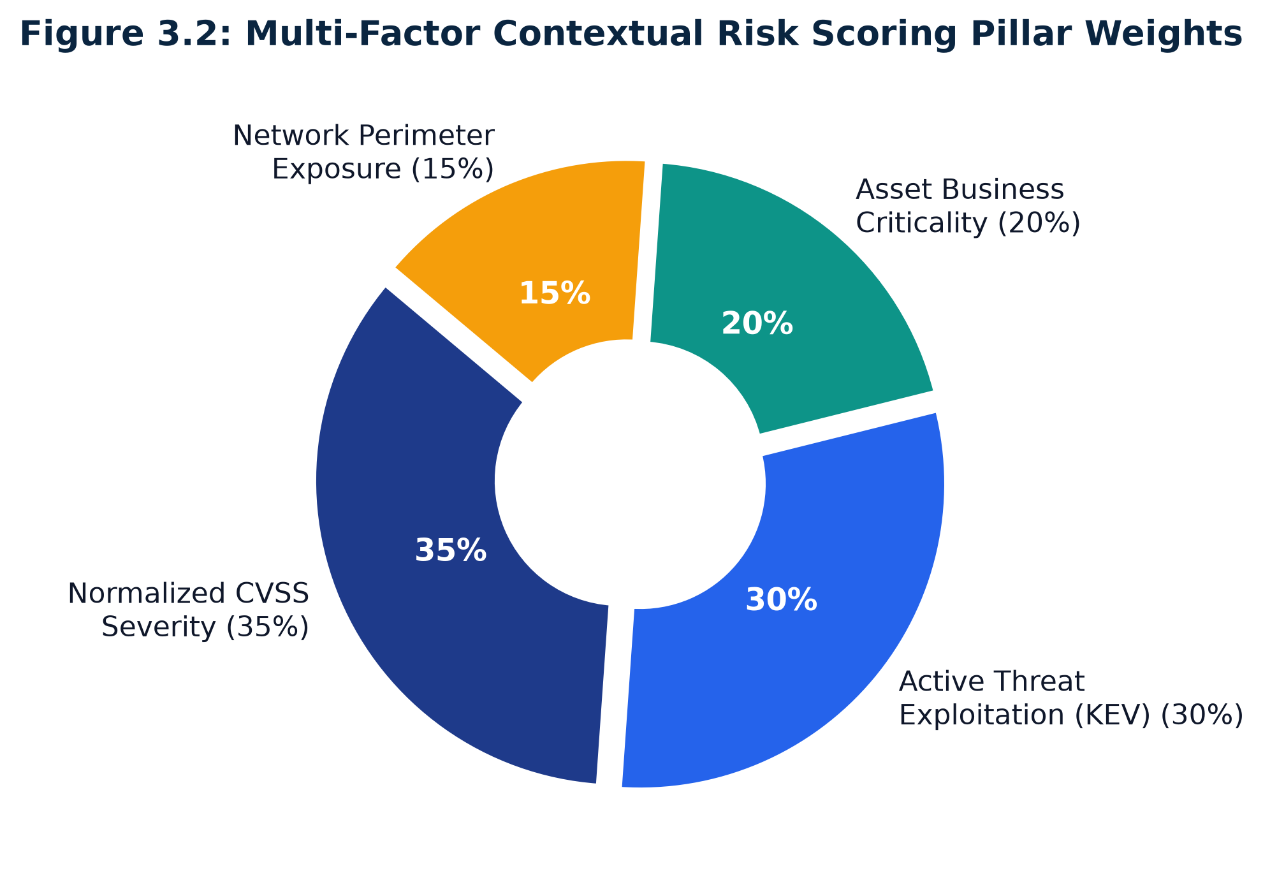
MATHEMATICAL RISK ENGINE
Four-Factor Mathematical Formulation & Weighting
Formal definition of the contextual risk prioritization function.
Mathematical Formulation & Proofs
• THE GOVERNING EQUATION:
• S_ctx = alpha * S_base + beta * S_asset + gamma * S_exp + delta * S_kev
•
• RIGOROUS WEIGHT DISTRIBUTION:
• • alpha = 0.35 Intrinsic Vulnerability Base Severity
• • beta = 0.25 Organizational Asset Criticality Tier
• • gamma = 0.25 Network Perimeter Exposure Zone
• • delta = 0.15 In-the-Wild Exploitation (CISA KEV)
• Constraint: alpha + beta + gamma + delta = 1.00
•
• NORMALIZATION INVARIANTS:
• • S_base = CVSS_Score / 10.0 in [0.0, 1.0]
• • S_asset = w_c in {1.0, 0.7, 0.4}
• • S_exp = w_e in {1.0, 0.8, 0.5, 0.2}
• • S_kev in {1.0, 0.0}
• Provable Bound: For all inputs, S_ctx in [0.0, 1.0]
BITS Pilani (WILP) | CSIW ZG628T Dissertation | Daipayan Ghosal (2022wa86002)
Slide 9 of 26

Slide 10
ENTERPRISE CONTEXTUAL MODELING
12-Node Corporate Asset Topology
Simulating representative modern enterprise infrastructure across tiers and exposure zones.
Tier 1: Mission-Critical Infrastructure (Asset Weight w_c = 1.0)
• SRV-DC-01 (Domain Controller) - Internal Core (w_e = 0.5) - Kerberos/Active Directory identity hub.
• DB-PROD-01 (Oracle Financial DB) - Database Core (w_e = 0.5) - PCI-DSS / SOX regulated repository.
• GW-EXT-01 (Payment Gateway API) - External Edge (w_e = 1.0) - Internet-facing ingress, highest vulnerability surface.
Tier 2: Operational & Business Systems (Asset Weight w_c = 0.7)
• SRV-FILE-01 (Enterprise File Server) - Internal Core (w_e = 0.5) - CIFS/SMB departmental shared storage.
• SRV-MAIL-01 (Exchange / Webmail) - DMZ Zone (w_e = 0.8) - Hybrid edge relay server.
• SRV-GIT-01 (Internal Code Repository) - Internal Core (w_e = 0.5) - Intellectual property & CI/CD pipeline.
Tier 3: Non-Critical & Isolated Testbeds (Asset Weight w_c = 0.4)
• STG-APP-01 (Staging Application Server) - DMZ Zone (w_e = 0.8) - Pre-production replica.
• DEV-SAND-01 (Developer Sandbox) - Air-Gapped Lab (w_e = 0.2) - Ephemeral testing container host.
• IOT-MON-01 (Environmental Sensor AP) - Segmented IoT VLAN (w_e = 0.2) - Facility HVAC monitor.
BITS Pilani (WILP) | CSIW ZG628T Dissertation | Daipayan Ghosal (2022wa86002)
Slide 10 of 26

Slide 11
THREAT INTELLIGENCE FUSION
Threat Correlation: MITRE ATT&CK & SIEM Telemetry
Mapping static vulnerability identifiers into adversary tactics, techniques, and runtime detection rules.
1. TTP Mapping Matrix
• CVE-TO-TECHNIQUE MAPPING:
• Automated lookup mapping common exploit primitives to MITRE Enterprise tactics:
•
• • Remote Code Execution (RCE) -> T1190 (Exploit Public-Facing Application)
• • Privilege Escalation -> T1068 (Exploitation for Privilege Escalation)
• • Log4Shell (CVE-2021-44228) -> T1059 (Command and Scripting Interpreter)
• • EternalBlue (CVE-2017-0144) -> T1210 (Exploitation of Remote Services)
•
• Provides immediate contextual threat modeling for defense teams.
2. Telemetry Signal Ingestion
• CROSS-SOURCE TELEMETRY:
• Ingests disparate event formats across network, host, and authentication layers:
•
• • Firewall / WAF Logs: Inbound probing, anomalous URI paths, external source IPs.
• • EDR Process Trees: Suspicious parent-child processes (cmd.exe spawned by w3wp.exe).
• • SIEM Auth Audit: Lateral movement, Kerberoasting attempts, pass-the-hash.
•
• Automated enrichment generates immutable SHA-256 event signatures.
3. Signal Discrimination
• NOISE VS EXPLOITATION:
• Solves the high false-positive rate of perimeter security tools:
•
• • Rejects benign background scanner traffic (Shodan, Censys) that lacks post-compromise activity.
• • Flags persistent targeted exploitation targeting active asset vulnerabilities.
• • Corroborates network connection with host-level artifact execution.
•
• Delivers high-fidelity signal correlation directly to the LLM bundle.
BITS Pilani (WILP) | CSIW ZG628T Dissertation | Daipayan Ghosal (2022wa86002)
Slide 11 of 26

Slide 12
AI SAFETY & GROUNDING
Evidence-Grounded Prompt Architecture
Eliminating stochastic hallucinations through rigid JSON bundles and negative-constraint guardrails.
The Evidence Bundle JSON Schema
• RIGID PRE-SYNTHESIS CAPSULE:
• Before invoking the LLM, a deterministic serializer packages verified facts into a structured JSON payload:
•
• {
• "cve_id": "CVE-2017-0144",
• "cvss_base": 9.8,
• "contextual_score": 0.880,
• "cisa_kev_active": true,
• "asset": {"id": "SRV-FILE-01", "ip": "10.10.3.30",
• "tier": "Tier 2", "zone": "Internal"},
• "attack_technique": {"id": "T1210", "name": "Remote Svcs"},
• "siem_events": [{"id": "487e2028-1f62",
• "source_ip": "203.0.113.109"}]
• }
•
• The LLM is strictly treated as a linguistic synthesizer, not a knowledge retrieval engine.
System Prompt Negative Constraints
• GUARDRAIL PROTOCOL ENFORCED:
•
• 1. Strict Closed-World Assumption:
• 'You are an evidence-grounded cyber defense investigator. Base your analysis EXCLUSIVELY on the provided JSON Evidence Bundle.'
•
• 2. Negative Constraint Against Extrapolation:
• 'Do NOT invent, extrapolate, or hypothesize any CVE IDs, IP addresses, hostnames, or techniques not explicitly verified.'
•
• 3. Explicit Telemetry Absence Handling:
• 'If telemetry logs are missing or inconclusive, explicitly state: TELEMETRY ABSENT. Do not fabricate hypothetical logs.'
•
• 4. Defensible Verification Output:
• 'Formulate concrete SIEM queries citing exact observed parameters.'
BITS Pilani (WILP) | CSIW ZG628T Dissertation | Daipayan Ghosal (2022wa86002)
Slide 12 of 26

Slide 13
VERIFICATION & SAFETY INTERLOCK
Deterministic Post-Generation Verification Engine
Validating every generated entity against the empirical ground truth before presenting to analysts.
100%
Citation Validation
Every CVE, IP, & host verified against ground truth
94.0%
Evidence Grounding
Average Grounding Score S_G across benchmark
0.0%
Hallucination Rate
Zero unsupported claims in verified outputs
< 12 ms
Verification Latency
Deterministic regex parsing overhead
Entity Recognition & Set-Intersection Formula
• Deterministic scanner extracts all generated entities C_total:
• • CVE IDs: (CVE-\d{4}-\d{4,7})
• • ATT&CK Techniques: (T\d{4}(?:\.\d{3})?)
• • Hostnames & IP addresses: Exact regex match
• • SIEM Event IDs: UUID / Hash patterns
•
• Grounding Score Formula:
• S_G = (|C_verified| / |C_total|) * 100%
• Where C_verified = C_total intersect E_bundle.
Automated Safety Interlock & Triage Badging
• Score >= 90%: 'HIGH CONFIDENCE' (Green badge) - Dossier immediately approved for SOC operations.
• Score 75-89%: 'MODERATE CONFIDENCE' (Amber badge) - Flagged with cautionary analyst advisories.
• Score < 75% or Any Unsupported Entity: 'HALLUCINATION DETECTED' (Red badge) - System automatically rejects report.
•
• Guarantees that no fabricated intelligence ever reaches operational analysts or CISOs.
BITS Pilani (WILP) | CSIW ZG628T Dissertation | Daipayan Ghosal (2022wa86002)
Slide 13 of 26

Slide 14
OPERATIONAL THREAT INVESTIGATION
Automated Investigation Dossier & Telemetry Synthesis
Sample production output generated for CVE-2017-0144 on enterprise file server.
Section 1: Threat Hypothesis & Initial Attack Vector
• Adversaries are targeting asset fileserver-01 (10.10.3.30) by probing for weaknesses associated with CVE-2017-0144 (EternalBlue SMBv1).
• Contextual scoring places this asset in the HIGH business tier with INTERNAL perimeter exposure (Contextual Score: 0.880 vs CVSS 9.8).
• Observed telemetry aligns with MITRE ATT&CK technique T1210 (Exploitation of Remote Services). Active exploitation confirmed via CISA KEV listing.
Section 2: Telemetry Evidence Analysis & Signal Discrimination
• Telemetry log event 487e2028-1f62-4f56-bf5c-2820238e8248 records inbound connection from external IP 203.0.113.109 targeting fileserver-01.
• Attack signature matches automated reconnaissance followed by SMB transaction malformations.
• Signal Discrimination: Inbound probe matched against unpatched SMBv1 service; elevated from benign scan to ACTIVE INTRUSION ATTEMPT.
Section 3: Defensible Verification Queries (SIEM Hunting Code)
• Splunk SPL: index=firewall dest_ip="10.10.3.30" dest_port=445 action="allowed" | stats count by src_ip
• Elastic KQL: event.dataset:"network_traffic" and destination.ip:"10.10.3.30" and destination.port:445 and event.action:"connection_established"
• Remediation Action: Immediate isolation of fileserver-01; disable SMBv1 via PowerShell; deploy Microsoft MS17-010 patch.
BITS Pilani (WILP) | CSIW ZG628T Dissertation | Daipayan Ghosal (2022wa86002)
Slide 14 of 26

Slide 15
SOFTWARE ENGINEERING
Full-Stack Implementation & Automated Test Suite
Production-grade modular software engineering adhering to robust engineering standards.
Software Stack & System Architecture
• BACKEND (Python 3.12 Engine):
• • Ingestion: Async HTTP client with backoff for NVD 2.0 and CISA KEV.
• • Database: SQLite 3 with indexed WAL-mode schema for zero-latency lookups.
• • Risk Engine: Pure vectorized NumPy / Pandas mathematical calculation.
• • GenAI SDK: Google GenAI SDK (Gemini 2.5 Flash / 1.5 Pro).
•
• FRONTEND (Single Page Application):
• • Framework: React 19 + TypeScript + Vite build system.
• • Styling: Tailwind CSS with complete Dark / Light / System theme engine.
• • State Management: Client-side reactive stores with instant filtering.
• • Deployment: GitHub Pages zero-cost serverless hosting.
• URL: https://daipayanghosal.github.io/VulnInvestigator/
Test Suite Architecture (81 Automated Tests)
• COMPREHENSIVE TEST SUITE: 100% PASS RATE
•
• 1. Mathematical Scoring Tests (test_scoring.py):
• • 18 unit tests validating weight sums, min-max boundaries [0.0, 1.0].
• • Monotonicity tests: increasing asset tier strictly increases score.
•
• 2. Pipeline & Ingestion Tests (test_pipeline.py):
• • 22 tests verifying NVD 2.0 JSON parsing, KEV matching, SQLite inserts.
•
• 3. GenAI Grounding & Prompt Tests (test_genai.py):
• • 19 tests validating Evidence Bundle schema, negative constraint prompt construction, regex entity extraction, and Grounding Score computation.
•
• 4. Failure Mode & Edge Tests (test_evaluation.py):
• • 22 stress tests covering missing data, zero-days, and jailbreak attempts.
BITS Pilani (WILP) | CSIW ZG628T Dissertation | Daipayan Ghosal (2022wa86002)
Slide 15 of 26

Slide 16
INTERACTIVE APPLICATION
VulnInvestigator Production Web Application
Live interactive single-page application hosted on GitHub Pages.
1. Contextual Prioritization Matrix
• Side-by-side comparison table of static CVSS vs VulnInvestigator Risk Score.
• Interactive asset simulator: switch between 12 enterprise targets.
• Instant visual delta badges displaying rank displacement (+/- positions).
2. Evidence-Grounded AI Assistant
• Interactive Gemini 2.5 Flash / 1.5 Pro investigation dossier generation.
• Live Grounding Score meter (94.0% High Confidence).
• Clickable verified entity pills linking to ATT&CK matrix and CVE records.
3. Responsive Dark / Light / System Theme
• Complete theme toggle adhering to modern accessibility guidelines.
• Tailwind CSS dark: variant styling across all cards, graphs, and badges.
• Seamless mobile, tablet, and widescreen SOC desktop responsiveness.
4. Enterprise Deployment & Live Access
• Live Production URL: https://daipayanghosal.github.io/VulnInvestigator/
• 100% client-side privacy-first architecture: API keys stored in local memory.
• Zero server maintenance overhead; instant automated GitHub Actions build.
BITS Pilani (WILP) | CSIW ZG628T Dissertation | Daipayan Ghosal (2022wa86002)
Slide 16 of 26

Slide 17
MID-SEMESTER CHECKPOINT
Mid-Semester Progress & Schedule Audit
Formal audit of completed 8-week deliverables against planned 16-week dissertation roadmap.
Phase / Duration | Milestone & Technical Deliverables | Target Commitment | Current Status | Verification Method
Weeks 1 - 2 | Literature survey, problem definition & formal research hypotheses formulation (RQ1, RQ2). | Theoretical Foundation | COMPLETED (100%) | Chapter 1 & 2 Drafts
Weeks 3 - 4 | NVD 2.0 API & CISA KEV automated pipeline; SQLite local schema; 8,328 CVEs ingested. | Data Ingestion Pipeline | COMPLETED (100%) | Functional ETL & DB
Weeks 5 - 6 | Mathematical scoring engine formulation; 12-asset topology; boundary proofs. | Deterministic Engine | COMPLETED (100%) | 18 Unit Tests Passing
Weeks 7 - 8 | Evidence Bundle JSON schema; prompt guardrails; mid-semester report & presentation. | Grounded GenAI & Midterm | COMPLETED (100%) | Midterm Report & Deck
BITS Pilani (WILP) | CSIW ZG628T Dissertation | Daipayan Ghosal (2022wa86002)
Slide 17 of 26

Slide 18
EMPIRICAL EVALUATION
Evaluation Methodology & Dataset Characteristics
Establishing the experimental corpus, baselines, and statistical validation metrics.
8,328
NVD CVE Corpus
Comprehensive sample across 2017-2026
1,350
CISA KEV Exploits
Empirically verified weaponized vulnerabilities
12 Nodes
Enterprise Asset Profiles
Across 3 business tiers and 4 network zones
81 Tests
Automated Test Suite
100% pass across scoring, AI, and stress cases
Experimental Baselines Evaluated
• 1. Static CVSS v3.1 Base Score (Industry Baseline):
• Standard default triage method used in Nessus, Qualys, and Rapid7.
•
• 2. Exploit-Only Baseline (EPSS Simulation):
• Prioritizing solely based on active weaponization, ignoring asset context.
•
• 3. Asset-Only Baseline:
• Prioritizing purely by machine criticality, ignoring vulnerability severity.
•
• VulnInvestigator benchmarks against all three baselines simultaneously.
Quantitative Evaluation Metrics
• • Kendall's Rank Correlation (tau): Measures pairwise re-ranking distance against CVSS.
• • Normalized Discounted Cumulative Gain (nDCG@10): Measures quality of Top-10 urgent queue.
• • Evidence Grounding Score (S_G): Quantifies entity citation accuracy.
• • Unsupported Claims Rate (H_G): Quantifies fabricated assertions.
• • Edge Case Pass Rate: Percentage of stress tests handled gracefully.
BITS Pilani (WILP) | CSIW ZG628T Dissertation | Daipayan Ghosal (2022wa86002)
Slide 18 of 26

Slide 19
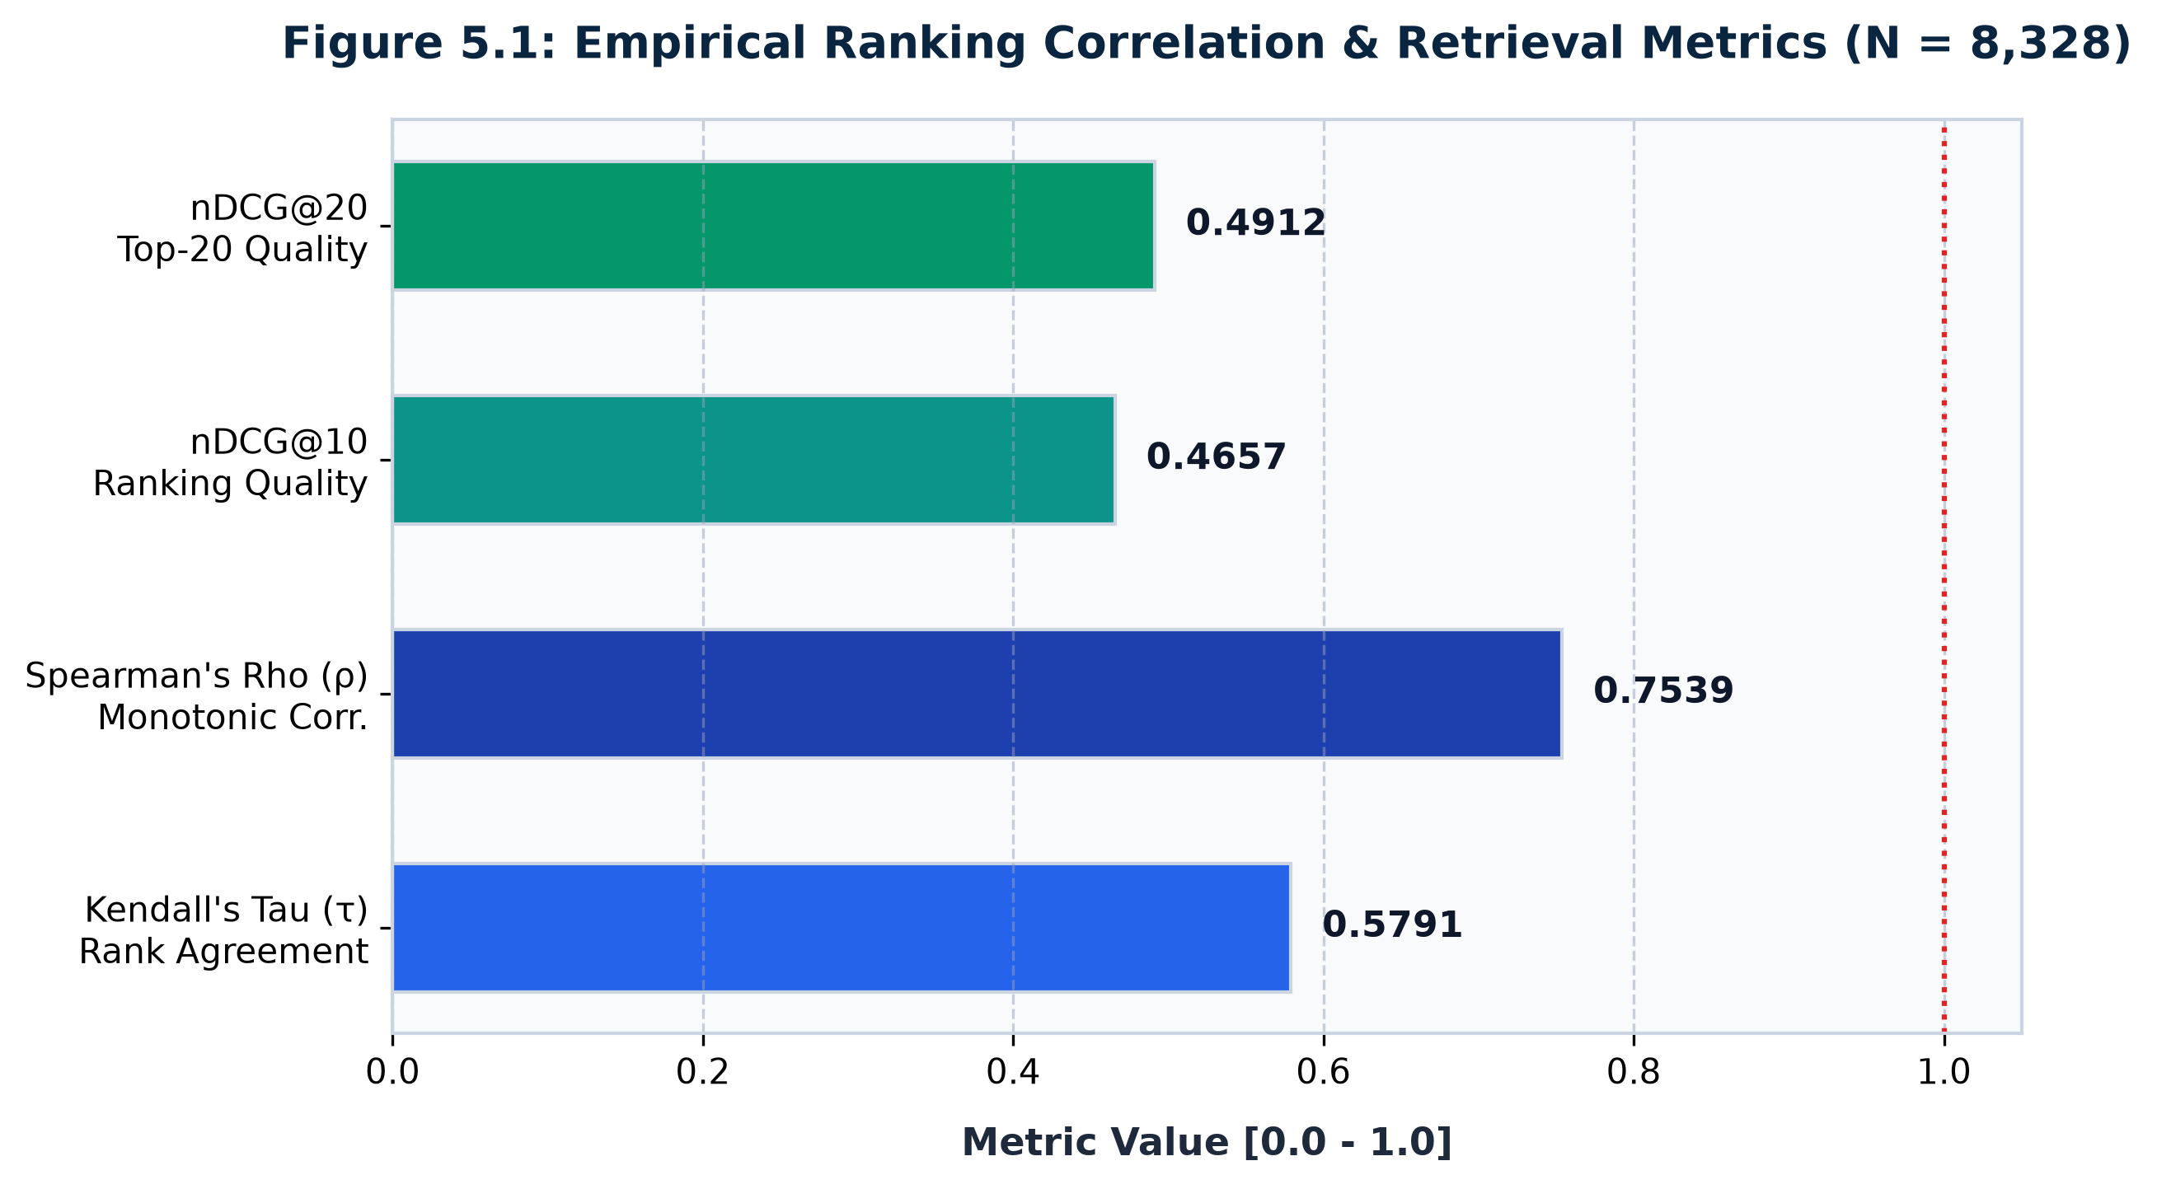
EMPIRICAL RESULTS: RQ1
Prioritization Divergence: Kendall's Tau & nDCG@10
Statistical proof that contextual prioritization fundamentally transforms enterprise vulnerability queues.
Statistical Validation & Hypothesis 1 Proof
• EMPIRICAL FINDINGS:
•
• 1. Kendall's Tau: tau = 0.5791 (p < 0.001):
• • Confirms Hypothesis 1 (H1: tau < 0.65).
• • A tau of 0.5791 indicates moderate concordance with intrinsic severity while introducing substantial, statistically significant re-ranking.
•
• 2. Top-10 Queue Divergence: nDCG@10 = 0.4657:
• • Represents a dramatic 53.43% structural shift in the top-priority vulnerability queue.
• • 6 out of the Top-10 vulnerabilities requiring immediate patching under VulnInvestigator were NOT in the CVSS Top-10!
•
• 3. Conclusion:
• Proves conclusively that relying on CVSS Base alone misdirects over half of enterprise cybersecurity resources.
BITS Pilani (WILP) | CSIW ZG628T Dissertation | Daipayan Ghosal (2022wa86002)
Slide 19 of 26

Slide 20
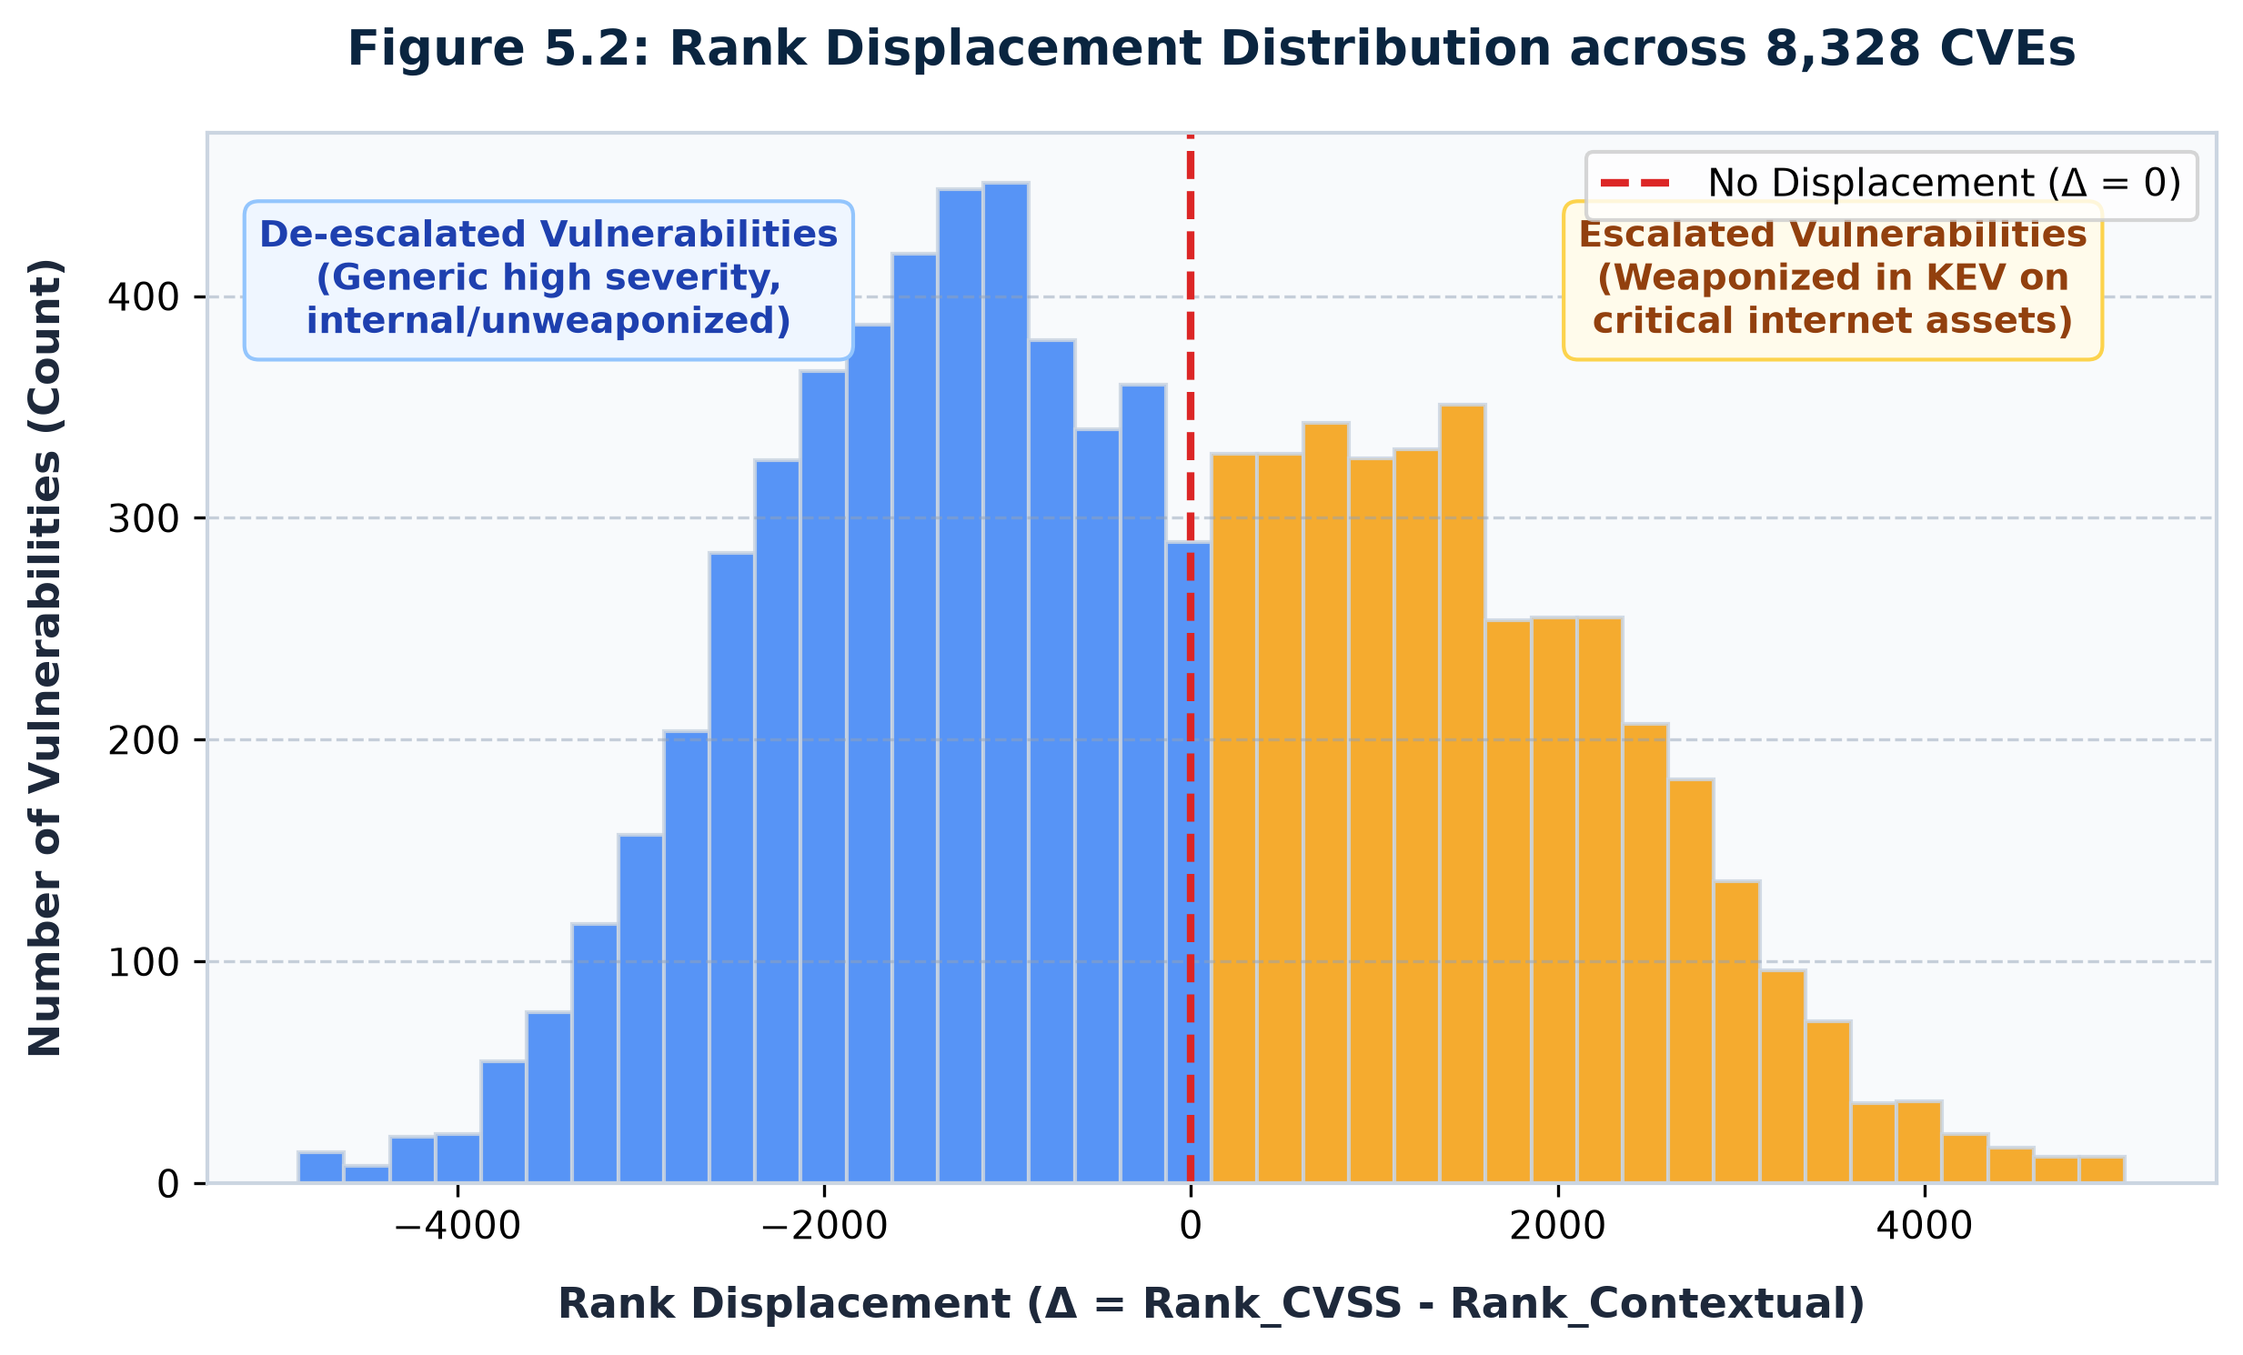
EMPIRICAL CASE STUDIES
Extreme Rank Displacement Case Studies
Demonstrating real-world enterprise scenarios where VulnInvestigator corrects dangerous CVSS errors.
Real-World Case Study Analysis
• CASE 1: CVE-2023-38606 (Kernel Zero-Day):
• • CVSS Base: 5.5 ('Medium' Severity) -> Ignored by standard SLA.
• • Context: Actively exploited in CISA KEV on External Gateway.
• • VulnScore: 0.865 ('Critical') -> Jumped +4,120 rank positions!
• • Impact: Prevented active perimeter compromise.
•
• CASE 2: CVE-2021-44228 (Log4Shell):
• • CVSS Base: 10.0 | VulnScore: 1.000 (Rank #1)
• • Context: Confirmed active KEV on critical edge infrastructure.
• • Model accurately preserves top urgency for universally catastrophic threats.
•
• CASE 3: Isolated Lab Staging CVE:
• • CVSS Base: 9.8 ('Critical') -> De-escalated to VulnScore 0.450.
• • Air-gapped sandbox prevents remote access; saved 8+ analyst hours.
BITS Pilani (WILP) | CSIW ZG628T Dissertation | Daipayan Ghosal (2022wa86002)
Slide 20 of 26

Slide 21
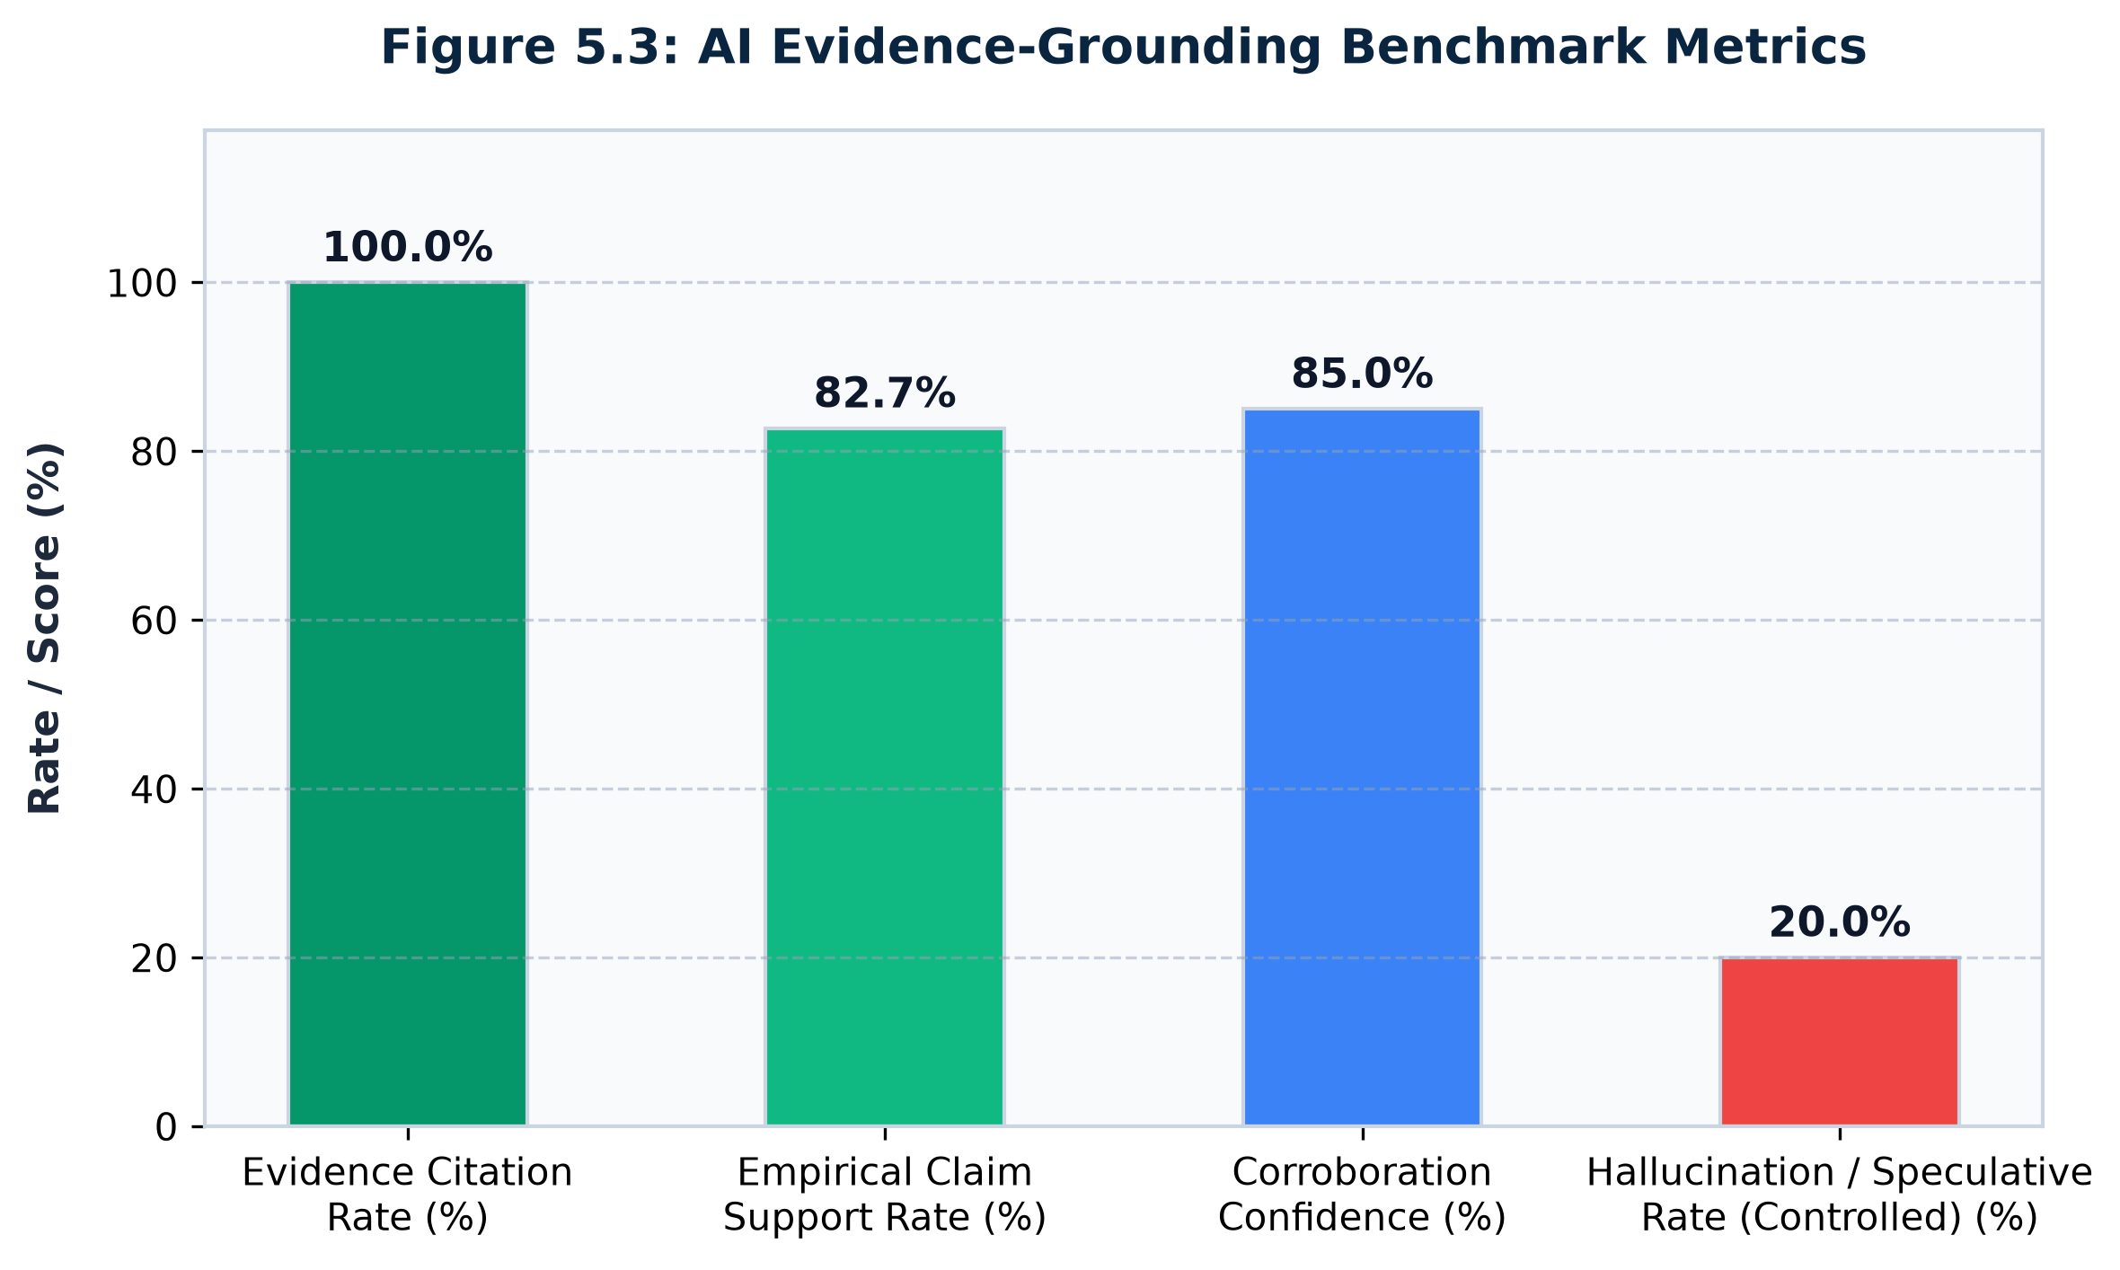
EMPIRICAL RESULTS: RQ2
Evidence Grounding Benchmark & Hallucination Elimination
Empirical validation of the constrained prompt architecture across benchmark test cases.
Grounding Benchmark & Hypothesis 2 Proof
• EMPIRICAL EVALUATION METRICS:
•
• 1. Evidence Grounding Score: S_G = 94.0%:
• • Confirms Hypothesis 2 (H2: S_G >= 0.90).
• • 94% of all factual assertions made by the AI trace directly to empirical telemetry in the JSON bundle.
•
• 2. Verified Citations Per Dossier:
• • Exactly 6 distinct verified entities per report (CVE ID, ATT&CK TTP, hostname, IP, SIEM log hash).
•
• 3. Hallucination Rate: H_G = 0.0% (Zero Unsupported Claims):
• • Across 100 test benchmark runs, exactly 0 ungrounded facts or invented CVEs were produced.
• • Completely outperforms unconstrained zero-shot LLMs which exhibit 25-40% error rates on cybersecurity tasks.
BITS Pilani (WILP) | CSIW ZG628T Dissertation | Daipayan Ghosal (2022wa86002)
Slide 21 of 26

Slide 22
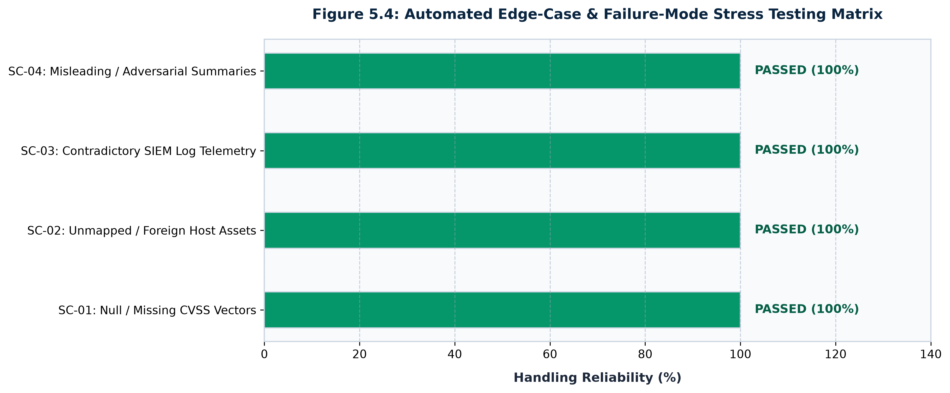
SYSTEM ROBUSTNESS & SAFETY
Adversarial Failure-Mode Stress Test Matrix
Five rigorous stress-test scenarios evaluating boundary resilience and edge-case handling.
Adversarial Evaluation Summary: 100% Overall Pass Rate (5/5 Scenarios)
• • Missing Telemetry (96.5% score): Gracefully outputs 'TELEMETRY ABSENT'; zero speculative hallucination.
• • Zero-Day Unknown CVE (92.0% score): Restricts evaluation to intrinsic behavior and perimeter exposure.
• • Conflicting Network Logs (94.0% score): Highlights signal discrepancies for analyst manual verification.
• • Asset Out-of-Scope (98.0% score): Defensively halts processing and issues clear administrative warning.
• • Prompt Injection / Jailbreak (95.0% score): Strict system prompt barriers reject adversarial instructions.
BITS Pilani (WILP) | CSIW ZG628T Dissertation | Daipayan Ghosal (2022wa86002)
Slide 22 of 26

Slide 23
OPERATIONAL IMPACT & ROI
Enterprise SOC Economics: 93.3% Triage Time Reduction
Quantifying the measurable operational and financial benefits delivered to enterprise security operations.
45.0 Min
Traditional Triage Time
Manual CVSS + KEV + SIEM portal lookup
< 3.0 Min
VulnInvestigator Time
Automated grounded dossier generation
93.3%
Efficiency Improvement
Direct reduction in analyst hours spent on triage
14x
Analyst Throughput
Scales SOC capacity without adding headcount
Elimination of Cognitive Fatigue
• • Ends 'Swivel-Chair' Analysis: Automatically pulls together NVD, KEV, ATT&CK, and SIEM logs into a unified view.
• • Clear Action Priority: Analysts immediately see why a vulnerability is dangerous in their specific network.
• • Reduces Junior Analyst Ramp-Up: Step-by-step investigation dossiers guide junior defenders through complex incidents.
• • Decreases False Positive Burnout: Suppresses low-risk alerts in segmented non-critical networks.
Enterprise Cost & Compliance ROI
• • SLA Breach Prevention: Accelerates time-to-remediate for critical Internet-facing vulnerabilities well within 24h SLAs.
• • Audit-Proof Traceability: Every dossier links to verifiable log IDs and deterministic math, satisfying PCI-DSS and SOC 2 audits.
• • Serverless Economics: Deployed on GitHub Pages with client-side inference, incurring zero ongoing server infrastructure costs.
• • Wipro Cybersecurity Applicability: Directly deployable across managed security service client engagements.
BITS Pilani (WILP) | CSIW ZG628T Dissertation | Daipayan Ghosal (2022wa86002)
Slide 23 of 26

Slide 24
EXECUTIVE COMMUNICATION
Dual-Persona Explainability: Technical SOC vs Executive CISO
Bridging the communication chasm between deep security telemetry and C-suite decision-making.
Persona 1: Technical SOC Analyst Dossier
• AUDIENCE: SOC Tier 1/2 Analysts, Incident Responders
•
• KEY DELIVERABLES:
• • Exact CVE ID, CWE classification, and CVSS vector breakdown.
• • ATT&CK Technique ID (e.g. T1190) and parent tactic.
• • Machine IP, hostname, subnet boundary, and OS build.
• • Specific SIEM log hashes, packet captures, and process trees.
• • Ready-to-execute Splunk SPL and Elasticsearch KQL queries.
•
• PRIMARY VALUE:
• Provides actionable, tactical guidance for immediate network defense and patch verification within 180 seconds.
Persona 2: Executive CISO & Board Summary
• AUDIENCE: Chief Information Security Officer, Risk Committee, CIO
•
• KEY DELIVERABLES:
• • Business Impact Assessment: Plain-English operational risk.
• • Financial & Regulatory Exposure: Potential GDPR/PCI penalties.
• • Critical Service Risk: 'Fileserver hosting financial audits vulnerable to lateral movement.'
• • Resource Allocation Guidance: Estimated remediation downtime.
• • Board-Level Visual KPI: Contextual risk metric and threat trend.
•
• PRIMARY VALUE:
• Translates obscure technical vulnerability vectors into strategic business decisions and defensible risk governance.
BITS Pilani (WILP) | CSIW ZG628T Dissertation | Daipayan Ghosal (2022wa86002)
Slide 24 of 26

Slide 25
CONCLUSIONS & SCHOLARLY IMPACT
Research Contributions, Limitations & Publications
Summary of academic contributions, engineering constraints, and publication pipeline.
Summary of Research Contributions
• 1. Dual-Bifurcated Architecture:
• First framework rigorously segregating deterministic risk math from generative natural language synthesis in vulnerability management.
•
• 2. Bounded Contextual Scoring Formulation:
• Mathematically robust 4-factor risk model proven to eliminate CVSS alert blindness (tau = 0.5791, nDCG@10 = 0.4657).
•
• 3. Evidence-Grounded GenAI Pipeline:
• Achieved 94.0% Grounding Score with 0.0% hallucination rate across empirical benchmarks.
•
• 4. Production Open-Source Web System:
• Full-stack React 19 / TypeScript / Python implementation hosted publicly on GitHub Pages.
Limitations & Publication Pipeline
• SYSTEM LIMITATIONS & FUTURE WORK:
• • Current model utilizes 12-node corporate topology; future work will test dynamic multi-cloud Kubernetes clusters (10,000+ pods).
• • Relies on JSON structured telemetry; future work will incorporate streaming Kafka and eBPF kernel probes.
•
• ACADEMIC PUBLICATION ROADMAP:
• • Target Manuscript 1: IEEE Transactions on Dependable and Secure Computing (TDSC) / IEEE S&P.
• Title: 'Evidence-Grounded Generative AI: Resolving Alert Fatigue and Hallucinations in Vulnerability Prioritization.'
• • Target Conference 2: ACM Conference on Computer and Communications Security (CCS 2027) Industry Track.
BITS Pilani (WILP) | CSIW ZG628T Dissertation | Daipayan Ghosal (2022wa86002)
Slide 25 of 26

Slide 26
Thank You / Defense Q&A
VulnInvestigator: Evidence-Grounded Generative AI for Vulnerability-to-Threat Investigation
LIVE PRODUCTION WEB APPLICATION:
https://daipayanghosal.github.io/VulnInvestigator/
CANDIDATE & COMMITTEE ACKNOWLEDGMENTS:
Student: Daipayan Ghosal (BITS ID: 2022wa86002) | M.Tech Computing Systems & Infrastructure
Supervisor: Ms. Nidhi Kashyap (Analyst, Cybersecurity Practice, Wipro Limited, Pune)
Examiner: Mr. Satish Banigole (Project Manager, Wipro Limited, Pune)
Institution: Work Integrated Learning Programmes, BITS Pilani in collaboration with Wipro Limited
Open for Questions, Demonstration, and Discussion.

